Slide 1
Min 15-30: Moodle Quiz (5 questions, 15 min)
Learning Objectives (Géron Ch17, Haynes et al.):
Define generative modeling
Know different ways of adding uncertainty to ML models
Understand how to evaluate such uncertainty estimates
Know three state-of-the-art generative models
Apprehend applications of latent data representations
Notes:
Questions?
Not graded

Slide 2
Min 30-60: Creating and Evaluating Uncertainty Estimates with Neural Networks for Environmental-Science Applications
Re-read the article and write down (1) the scientific goal of the paper; (2) One simple question with your neighbor. Example: How did the authors choose their best neural network architecture?

Slide 3
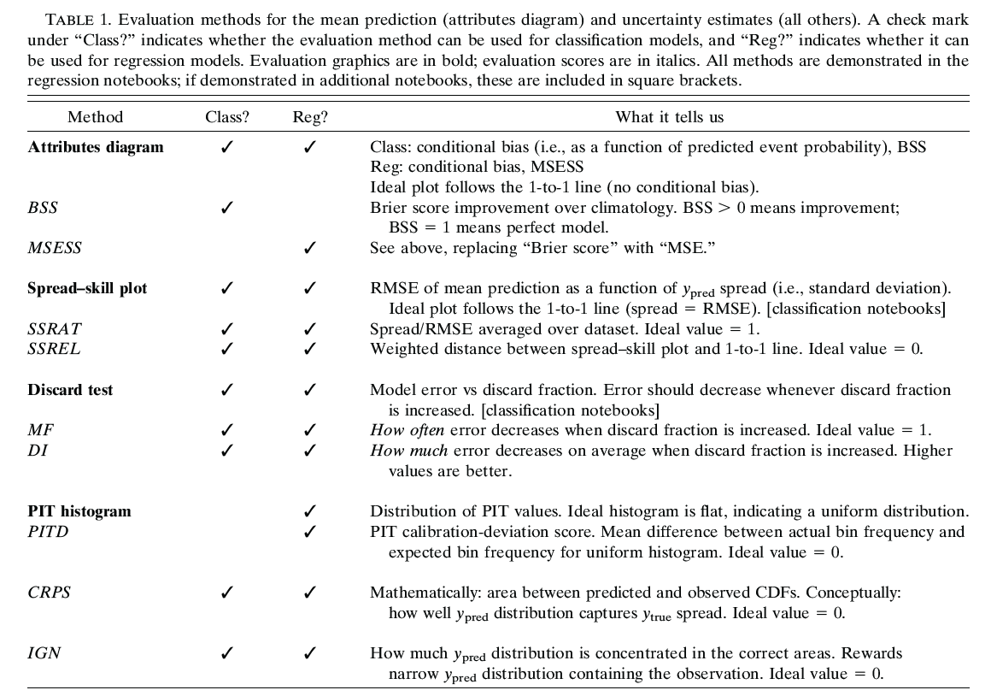

Slide 4
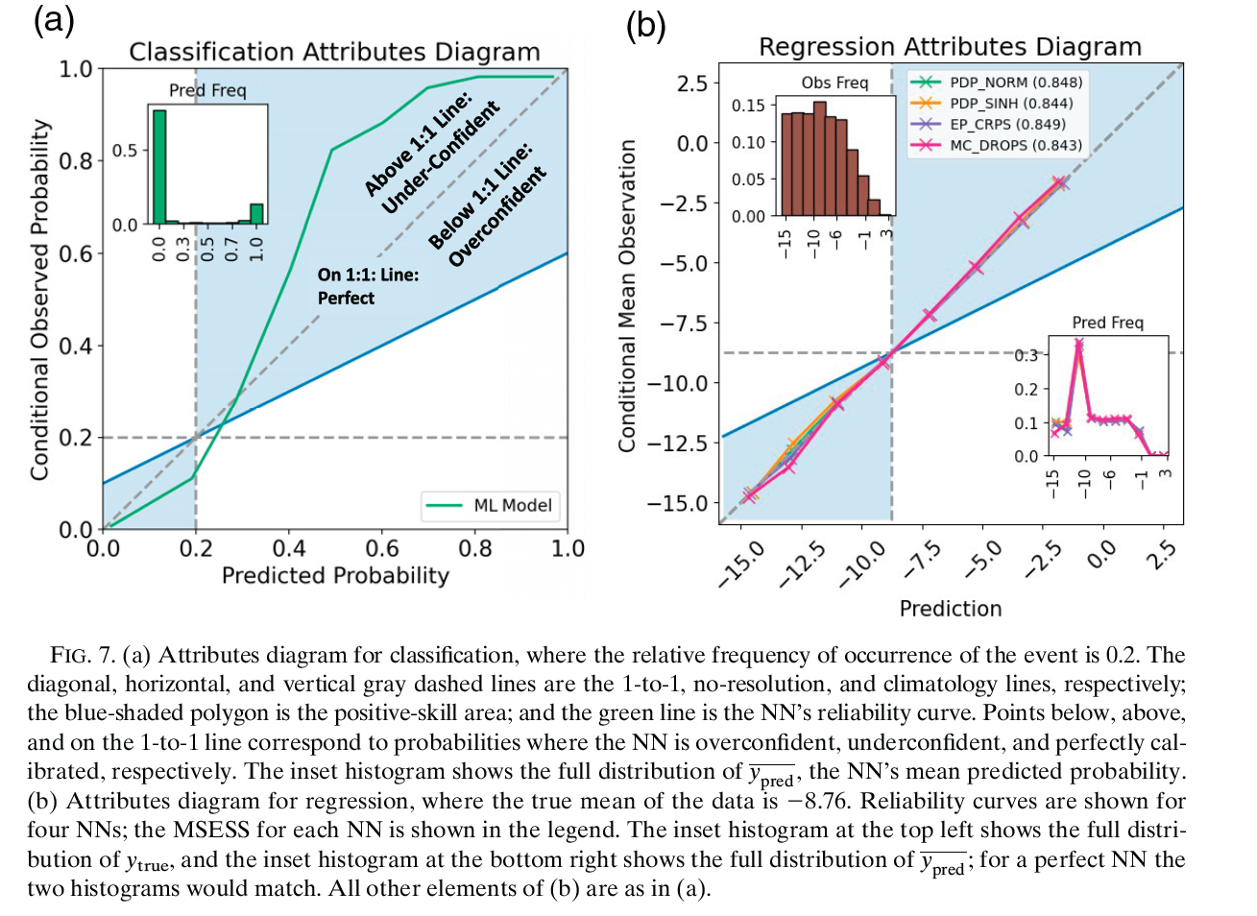

Slide 5
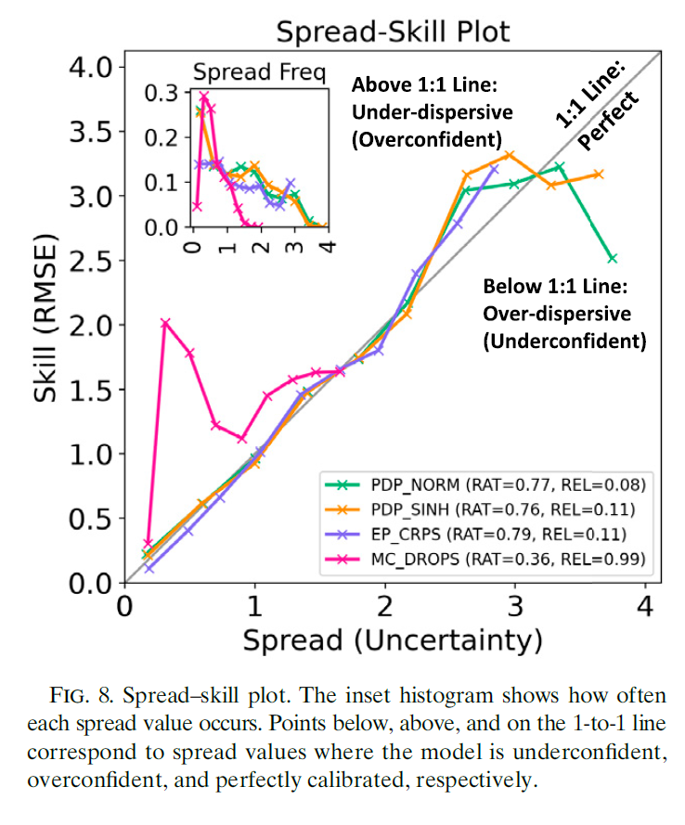
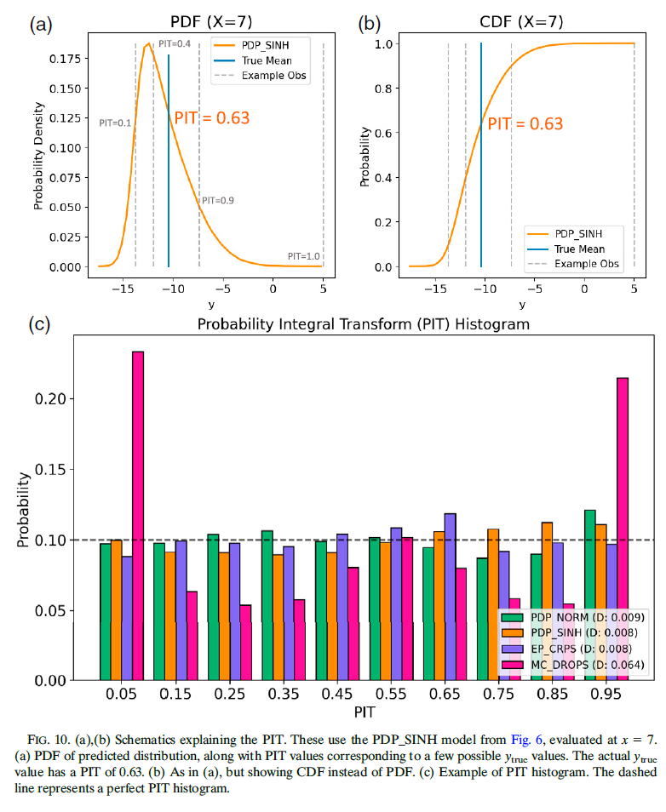

Slide 6
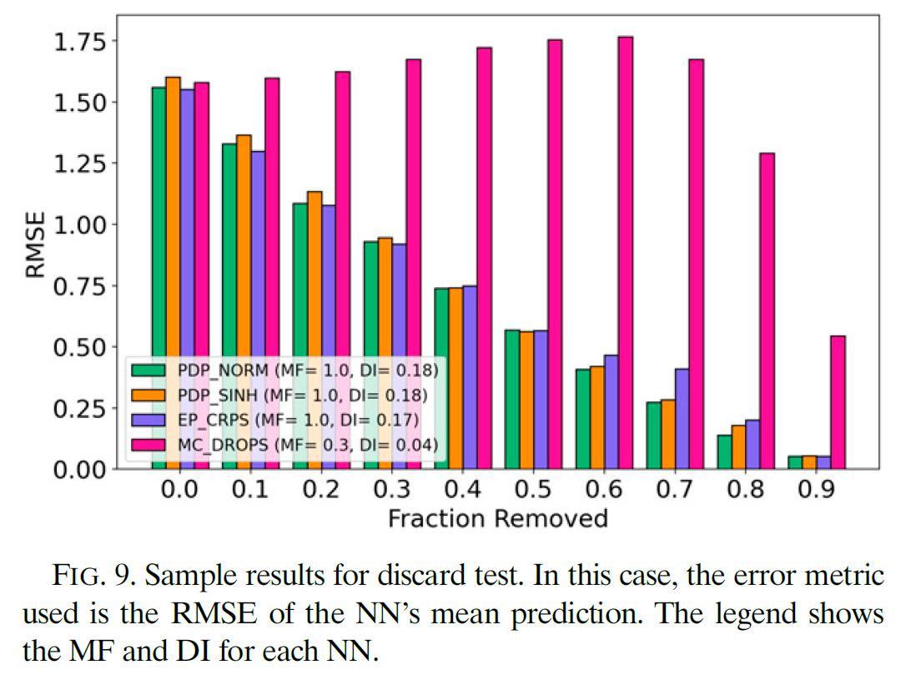

Slide 7
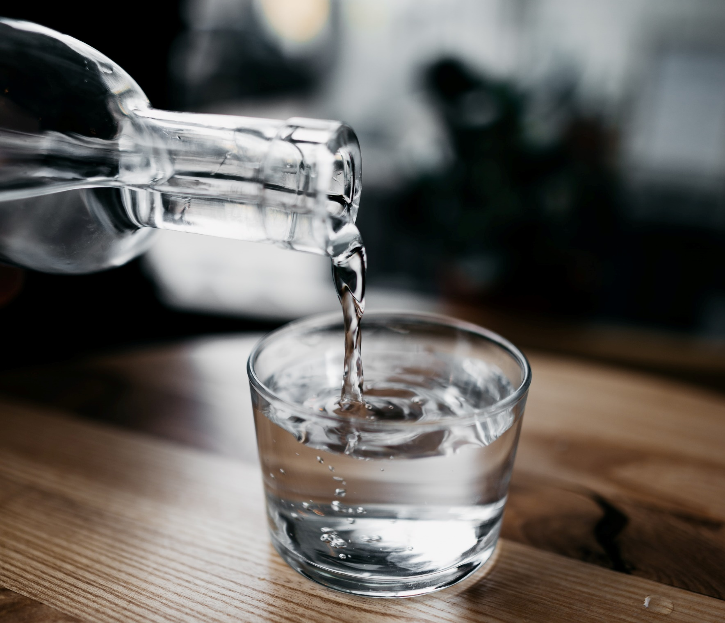
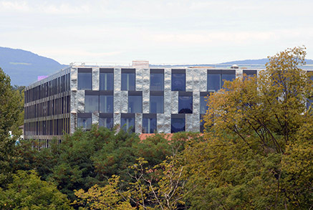
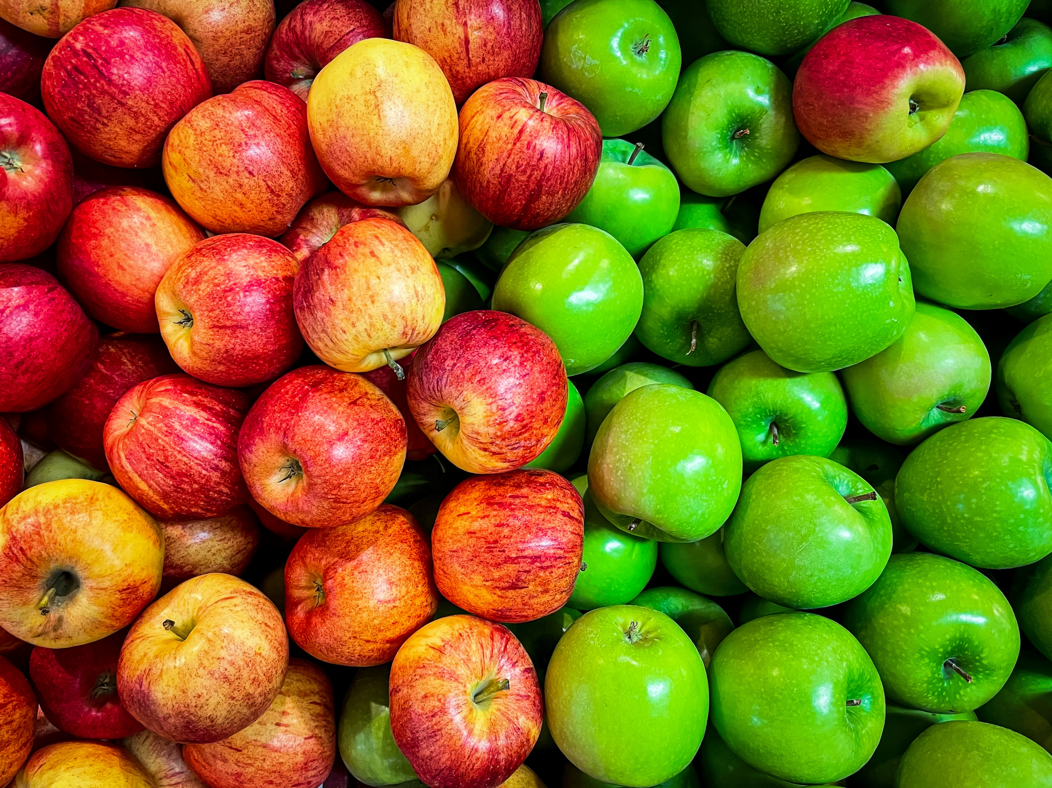
Min 60-75: Break

Slide 8


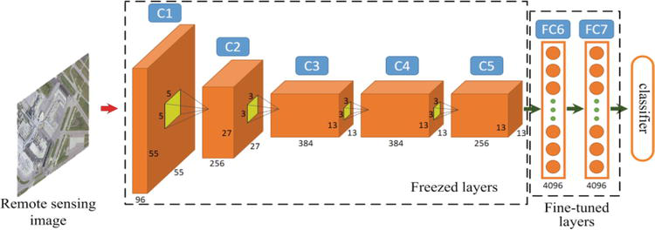
ML for Earth & Env Sci (Week 5, SP2022)
How can we extract information from images/videos using deep learning?
Source: Luo et al. (2018)
Notes:
COSERO hydrological model

Slide 9
Mid-term Presentations Wednesday, Nov 6th in Geopolis 2138 (10AM-Noon)
4min presentations + 6min Q&A/feedback
Tip = 1 slide/minute
Scientific question: What’s our goal and why do we care?
Dataset: Characteristics, challenges, training/validation/test split, etc.
Methodology: Which ML algorithm(s) are you planning to use and why?
Results: What are your initial results & what do you plan to do next?

Slide 10
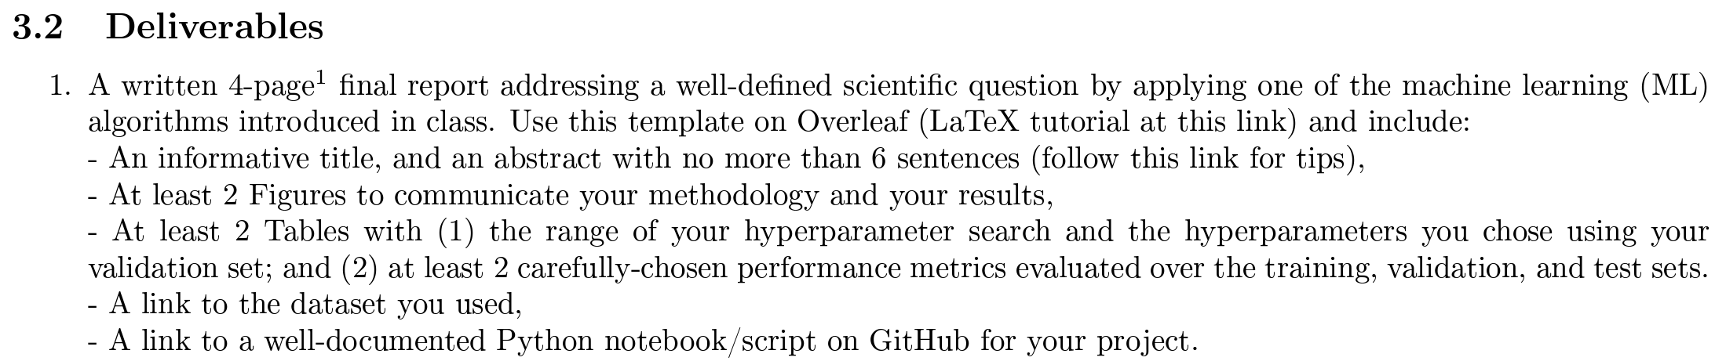
In-class Peer Review: Friday, Dec 6th, 2PM-4PM
Submit first draft of your project by Thursday, Dec 5th

Slide 11
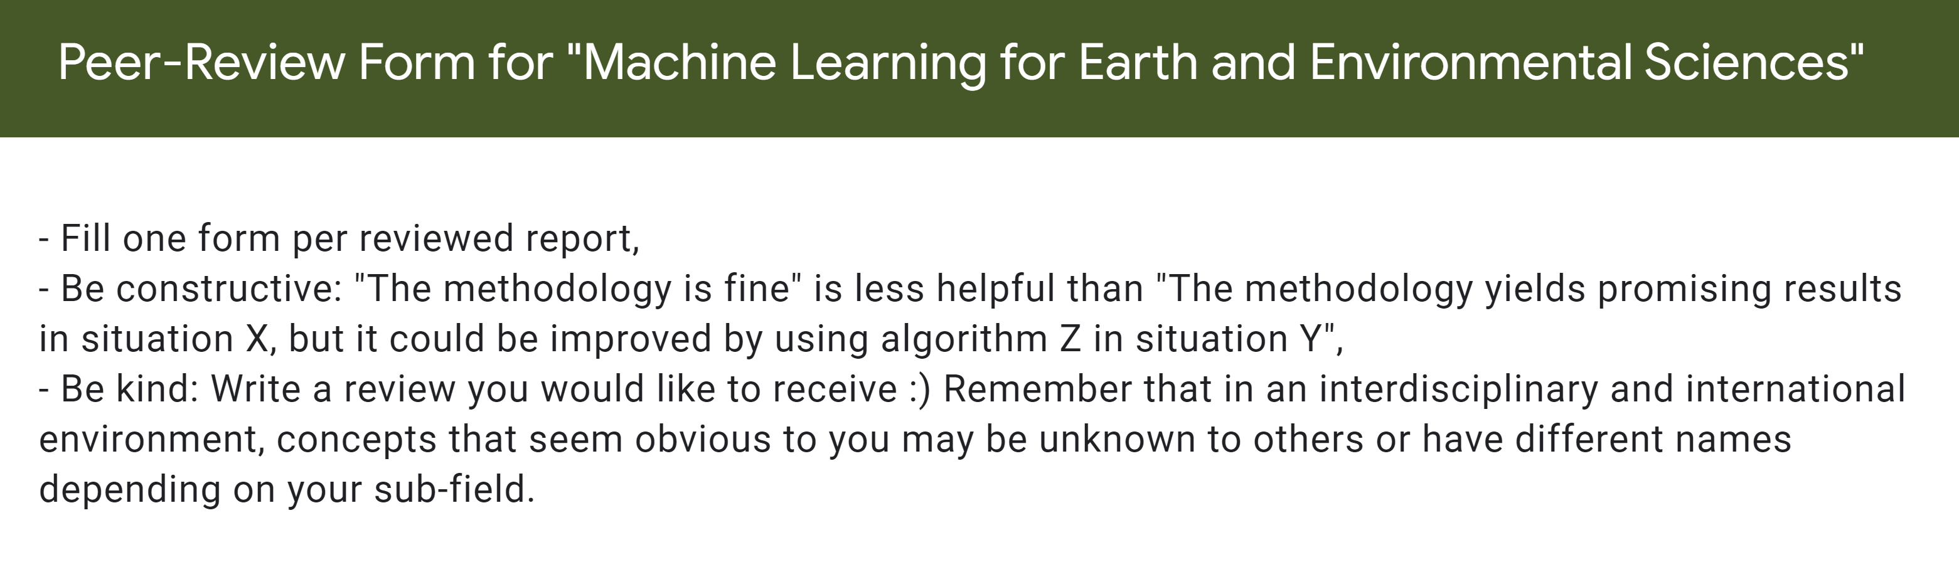
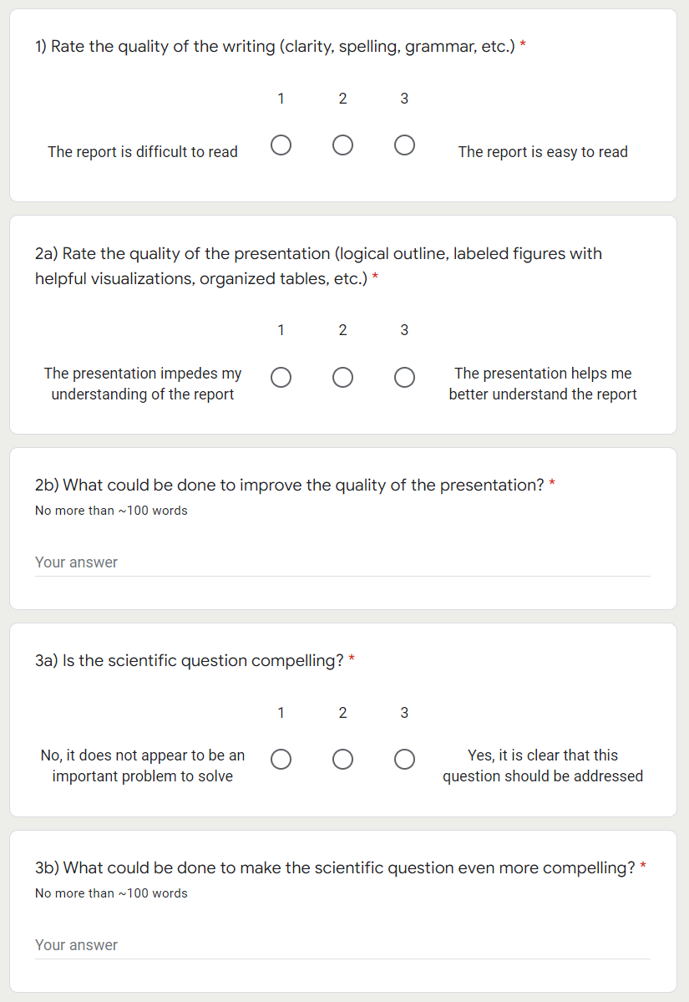
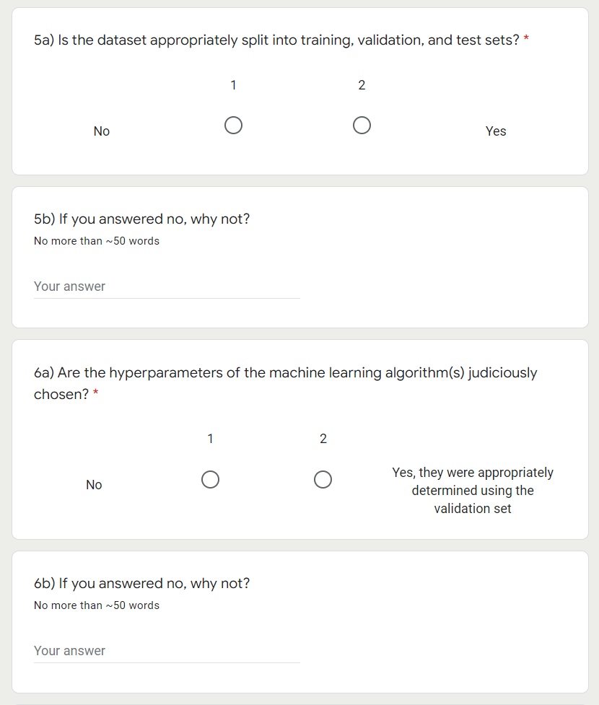

Slide 12
Final Presentations in room 2138 Friday, Dec 13th from 2PM to 4PM
4min presentations + 1min Q&A
Tip = 1 slide/minute
Scientific question: What’s our goal and why do we care?
Dataset: Characteristics, challenges, training/validation/test split, etc.
Methodology: Which ML algorithm(s) did you choose and why?
Results: What are your findings and how does it answer the sci. question?

Slide 13

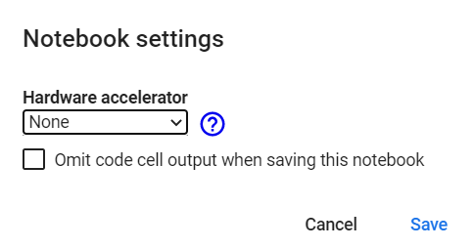

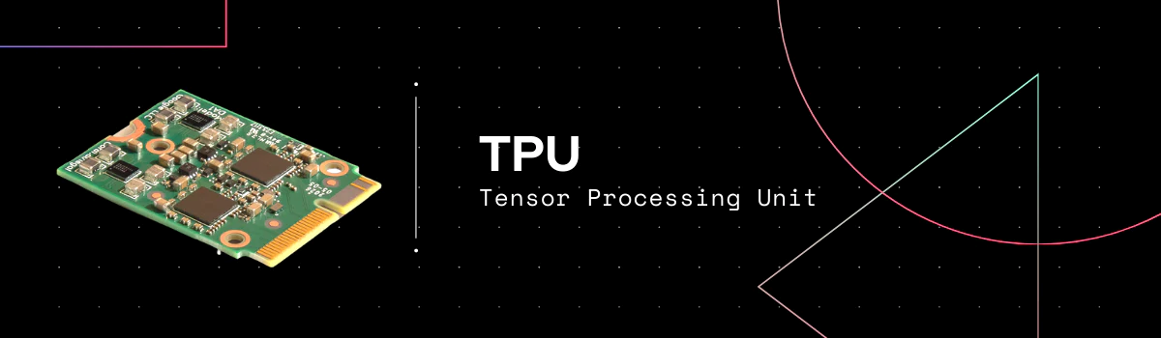
Only several cores but very precise
Executes instructions serially
Good for large models (large RAM), small batch sizes, custom calcs.
Has thousands of cores
Specialized for parallel processing
Good for larger batch sizes and deep learning in general
Specialized for matrix processing
Good for large batch sizes & CNN
(Edit menu)
Source: https://premioinc.com/blogs/blog/what-is-the-difference-between-cpu-vs-gpu-vs-tpu-complete-overview
Notes:
We talked about computational time, let’s briefly introduce hardware

Slide 14
Min 80-105: Convolutional Neural Networks to Process Images
Learning Objectives (Géron Ch14):
Define a convolutional neural network
Discuss the main applications of convolutional neural networks
Know the steps to design and train a convolutional neural network
Define transfer learning and understand how to re-use pre-trained models

Slide 15
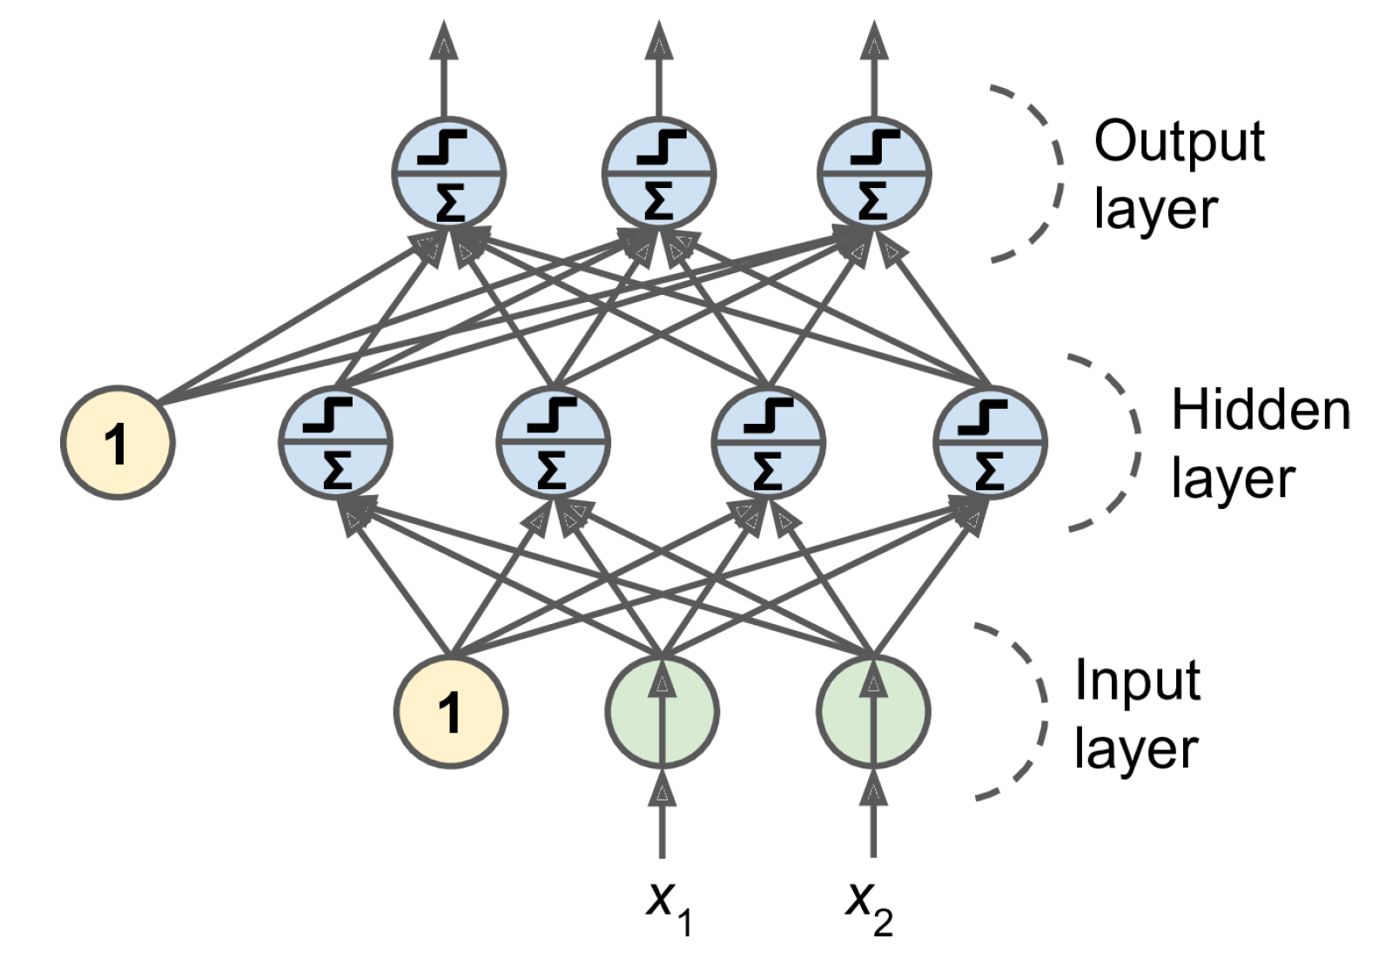
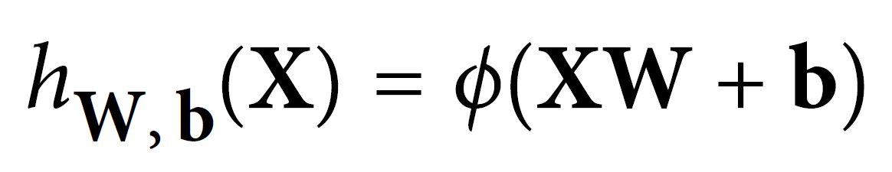
2 weeks ago = general case: Artificial Neural Networks
Notes:
1 layer = similar to logistic regression
2 layers = shallow neural network
Deep learning = 3 layers and above
VOTE 1: How many trainable parameters (weights and biases) in the input layer?
VOTE 2: If the input layer was a 10x10 image, how many trainable parameters?

Slide 16


This week: Convolutional Neural Networks (CNNs)
Regularized versions of Artificial Neural Networks used to process images
Source: Giphy, Analytics India Magazine (K. Maladkar)

Slide 17
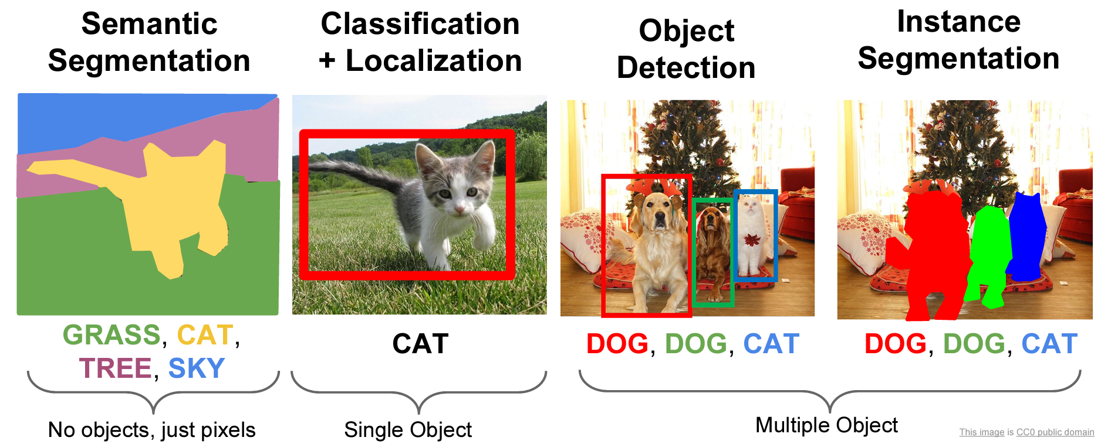
CNNs used for computer vision (analyzing images, videos)
Source: Stanford (CS231)

Slide 18
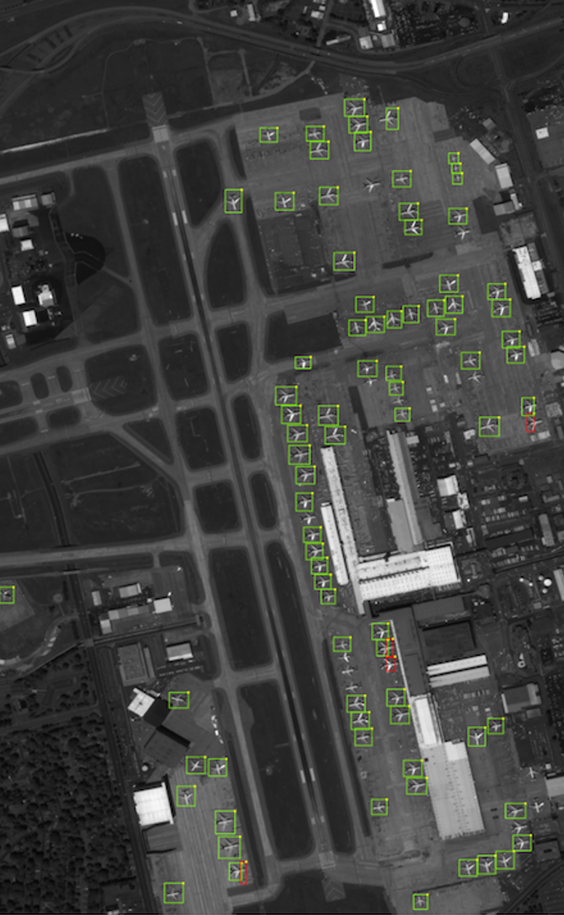
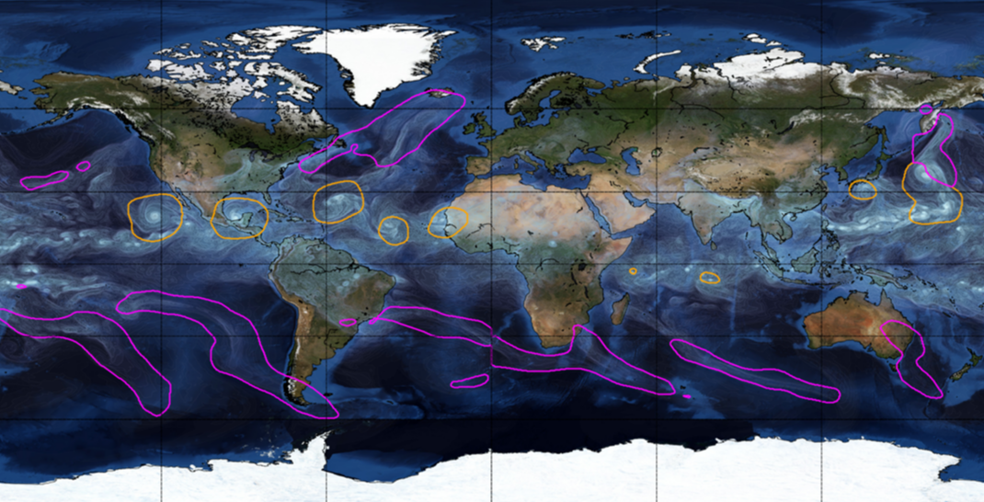
Object Detection for Remote Sensing
Instance Segmentation for Storm Detection
Source: Zhu et al. (2017), Prabhat et al. (2020)
Notes:
VOTE: Which output contains the most information?

Slide 19
Environmental Applications
Object Detection
Semantic Segmentation
catchment was flooded
classify parts of a catchment as being flooded or not.
In forestry, it could be classifying a remote sensing image into forest and non-forest
identifying every single tree in an image
"draw" the boundary of each rock glacier, individually
you will know for each pixel if this pixel "is in" a rock glacier, but you will not be able to know how many there is, just where there are rock glaciers on the picture

Slide 20
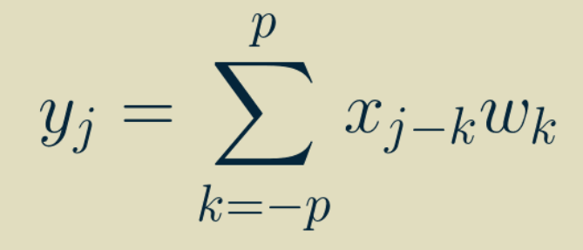
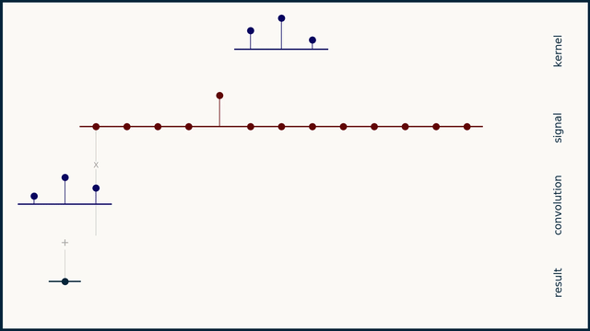
One-dimensional Convolution
Output
Input
Weights
Simple & inexpensive
Source: Brandon Rohrer
Notes:
VOTE: How many trainable parameters (weights and biases) for this operation?

Slide 21
Two-dimensional Convolution
↓
Two-dimensional weights
(Kernel, Filter)
3 x 3 receptive field
Notes:
VOTE: How many trainable parameters for this operation ?

Slide 22
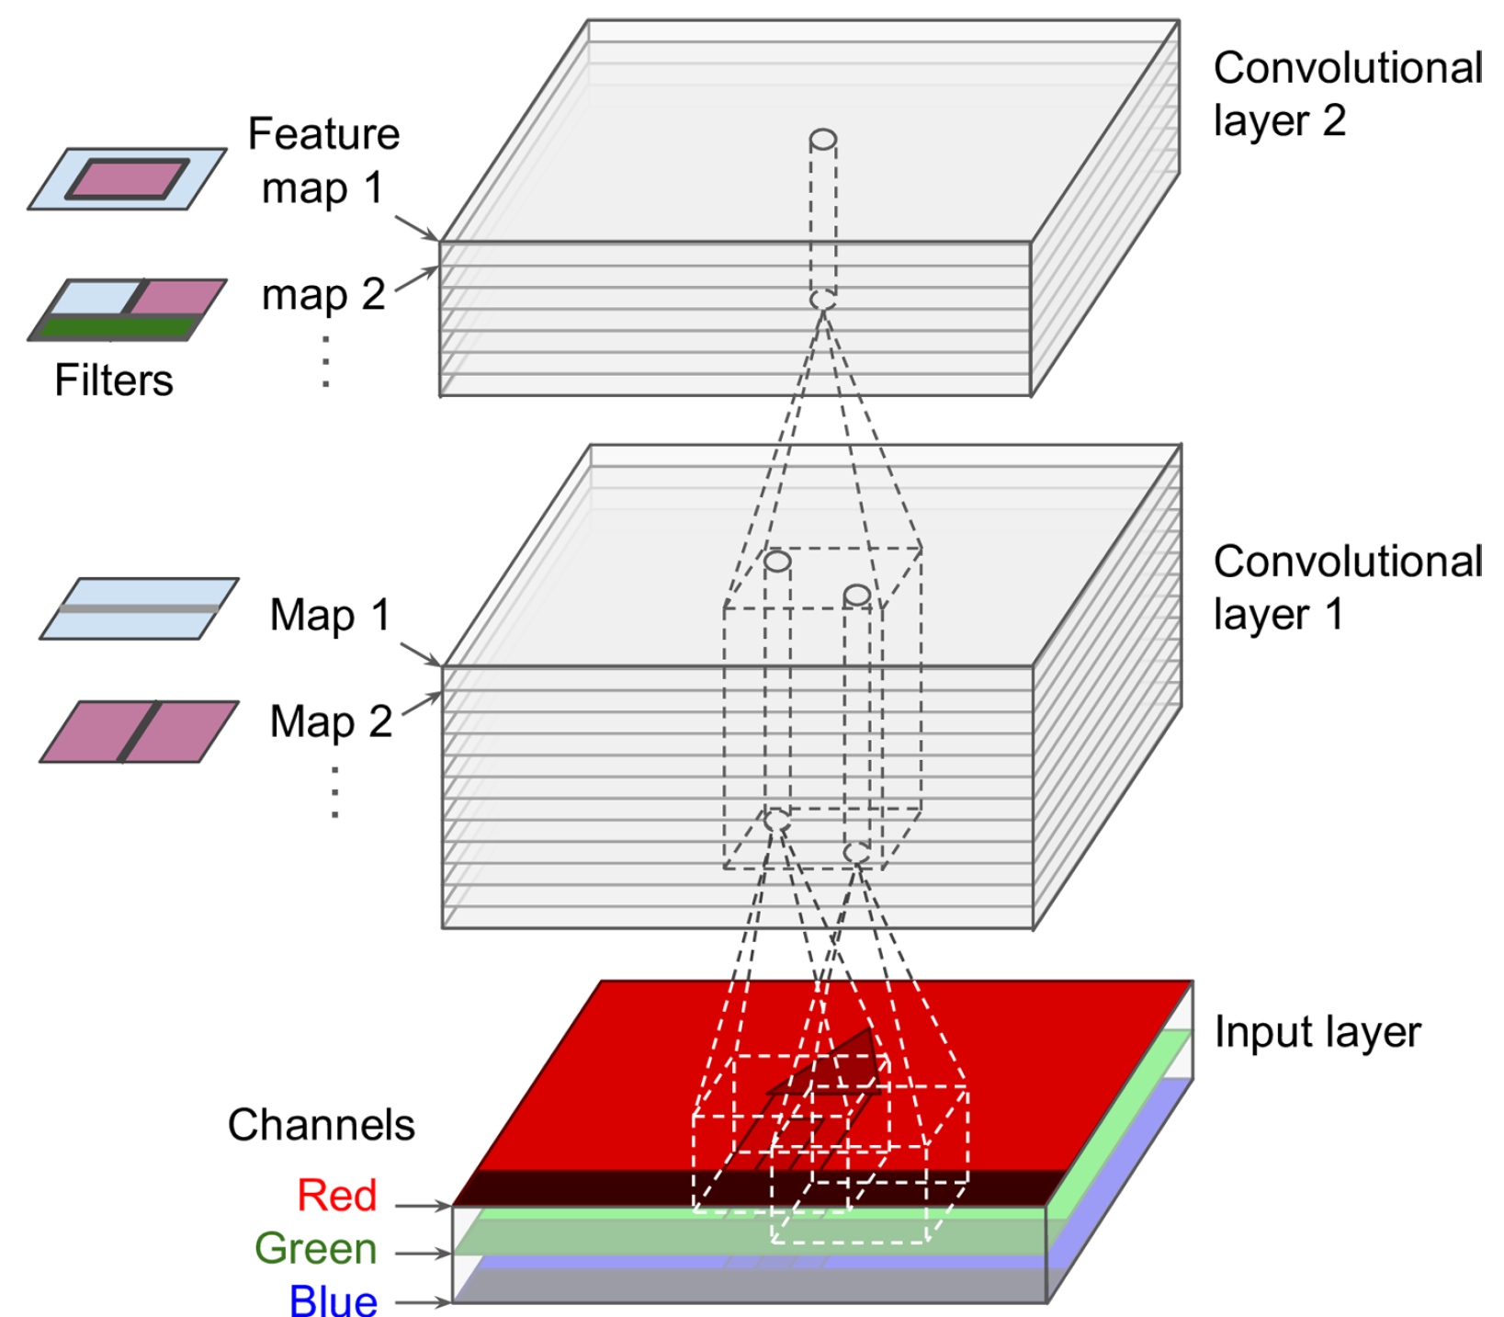
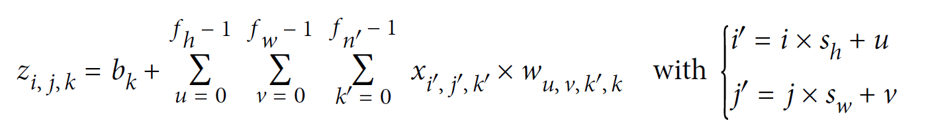
Two-dimensional Convolution with Multiple Features
Output
Input
Weights
Stride
Sum over height
Sum over width
Sum over features

Slide 23
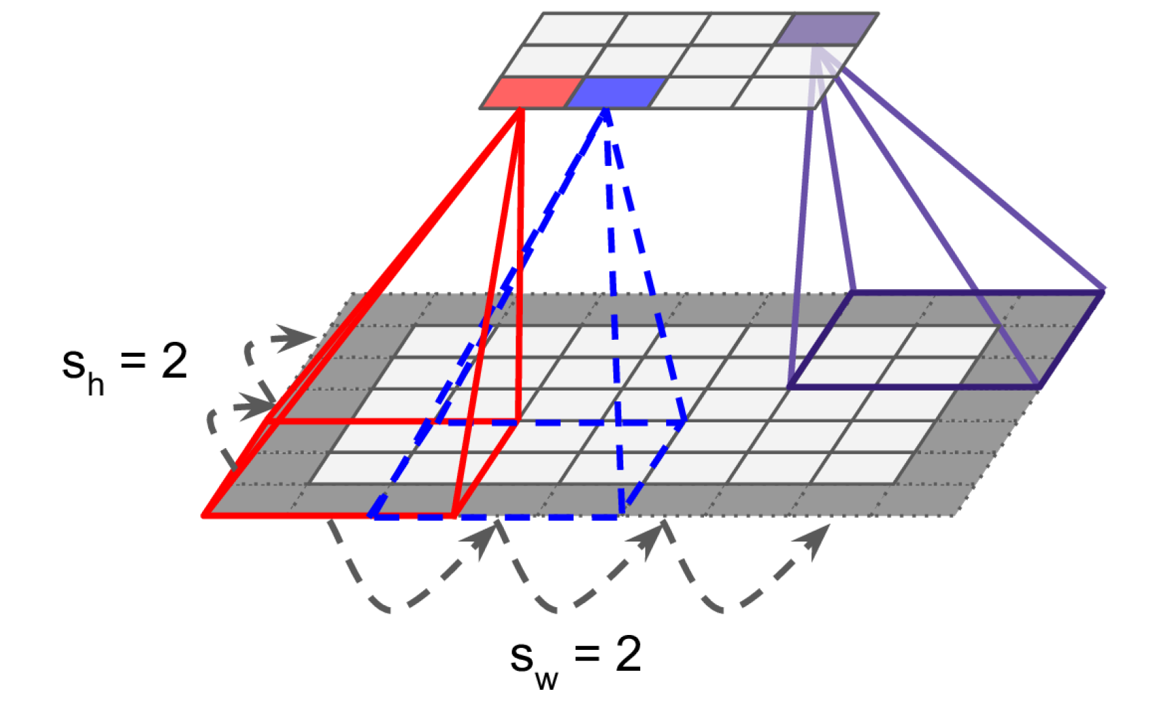
Reducing dimensionality using strides
Stride = “How much you move the filter by in each direction”
“Stride is one of the features used in defining the movement of the filter layer, which defines the amount of movement of the filter on the image. Each movement of the filter on the input image will produce one value, contributing to the output image. Now, if the stride is large, it means that the filter takes a big step at each step and, therefore, will produce fewer values and a smaller output compared with the original input.” 2022 student

Slide 24

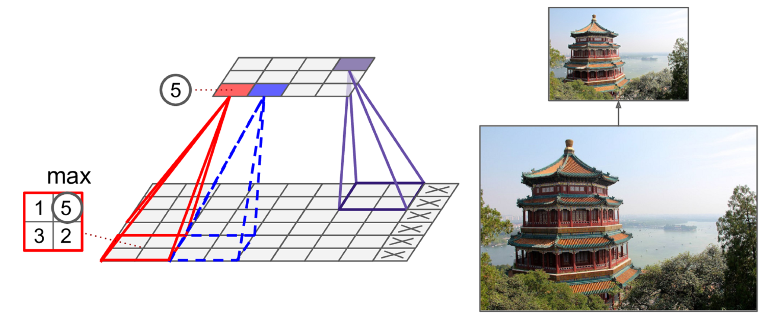
Shrinking the Input Image using Pooling Layers
Alternative: Mean/Average pooling
Notes:
Explain Difference between pooling and convolutional layer

Slide 25
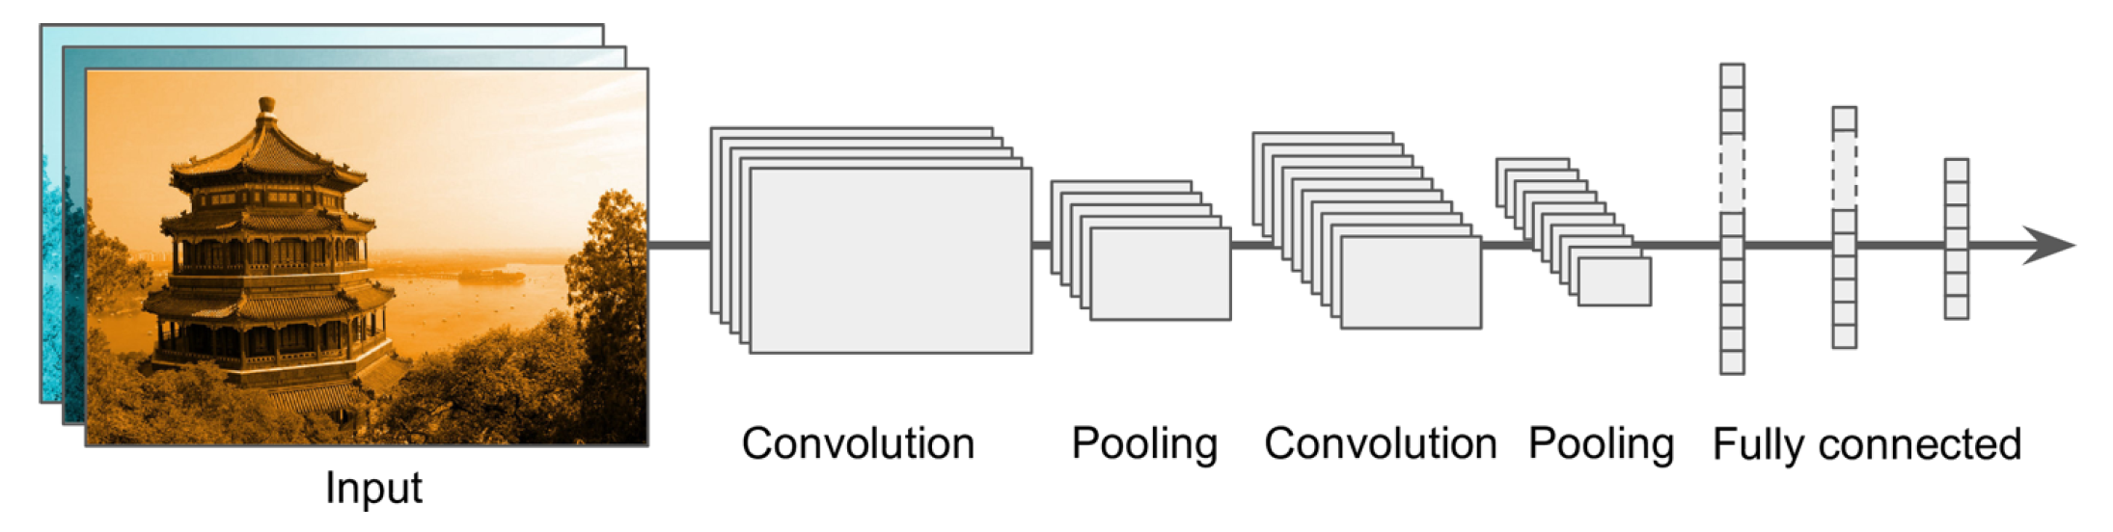

Building a Convolutional Neural Network
Prepare and load image dataset
Not enough data!

Slide 26
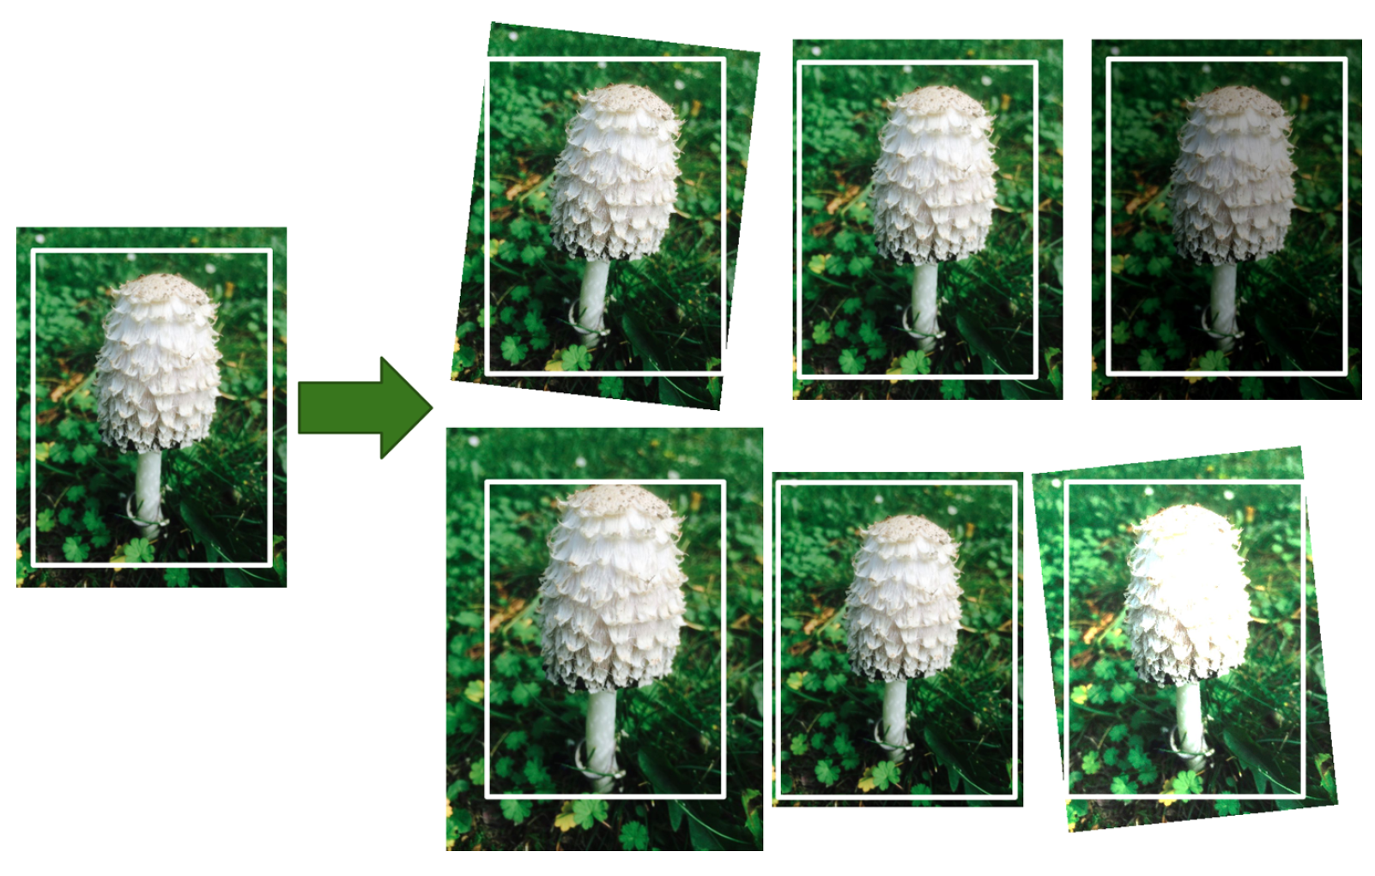
Data Augmentation = Generate realistic variances of each training instance (rotation, translation, resizing…)
Bonus: Regularizes the model

Slide 27
Building a Convolutional Neural Network
Prepare and load image dataset
First Convolution Operation
Image shrinks

Slide 28
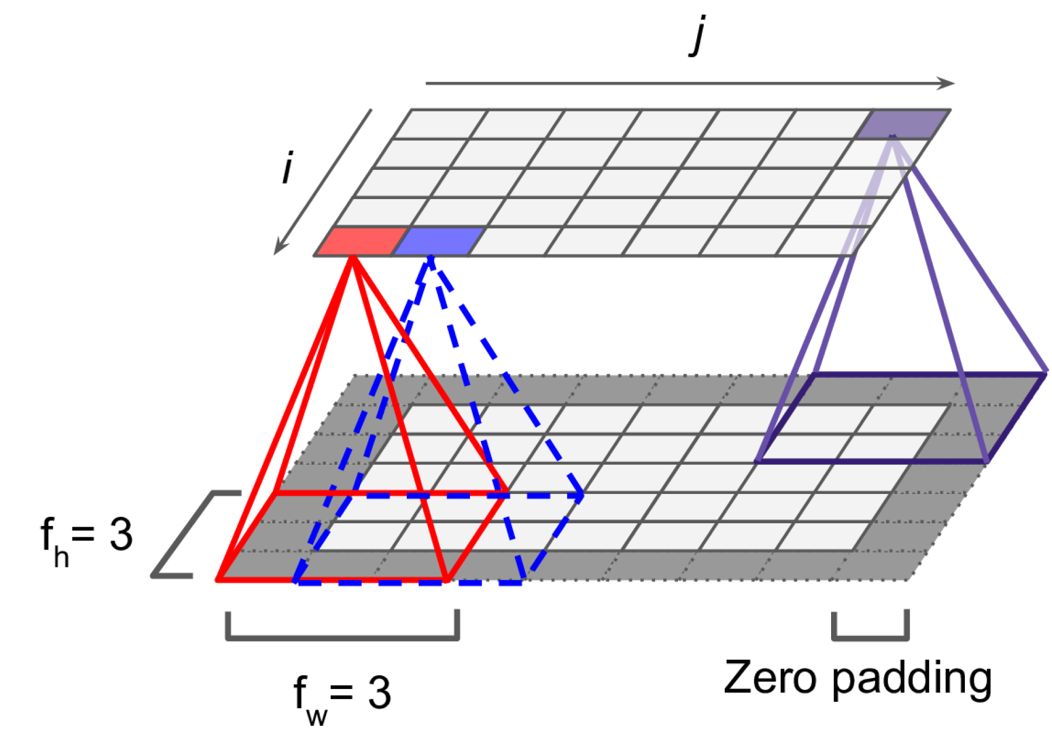
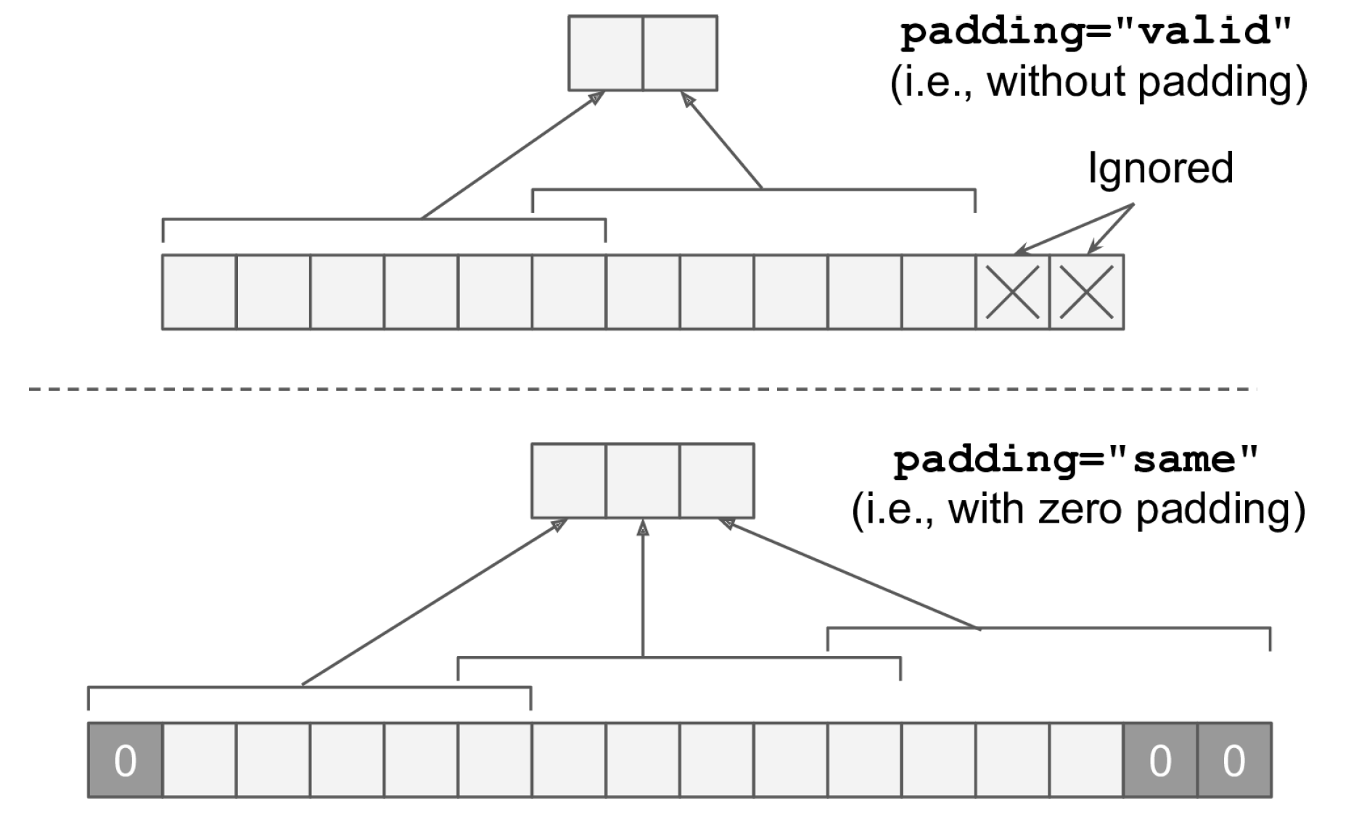
(Zero) padding to preserve the dimension of the input

Slide 29
Building a Convolutional Neural Network
Prepare and load image dataset
First Convolution Operation
Series of convolution+pooling
Dense layers

Slide 30
Train using appropriate loss (↓RAM use: ↓batch size, ↓layers, ↑strides, etc.)
Prepare and load image dataset
First Convolution Operation
Series of convolution+pooling
Dense layers

Slide 31

Building a Convolutional Neural Network
Prepare and load image dataset
Still not enough data!

Slide 32

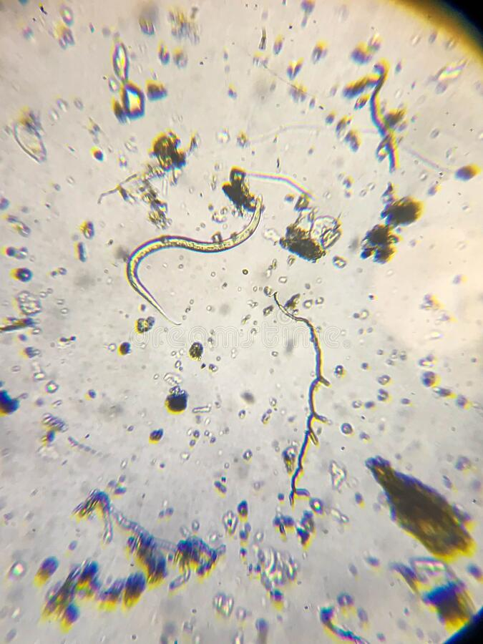
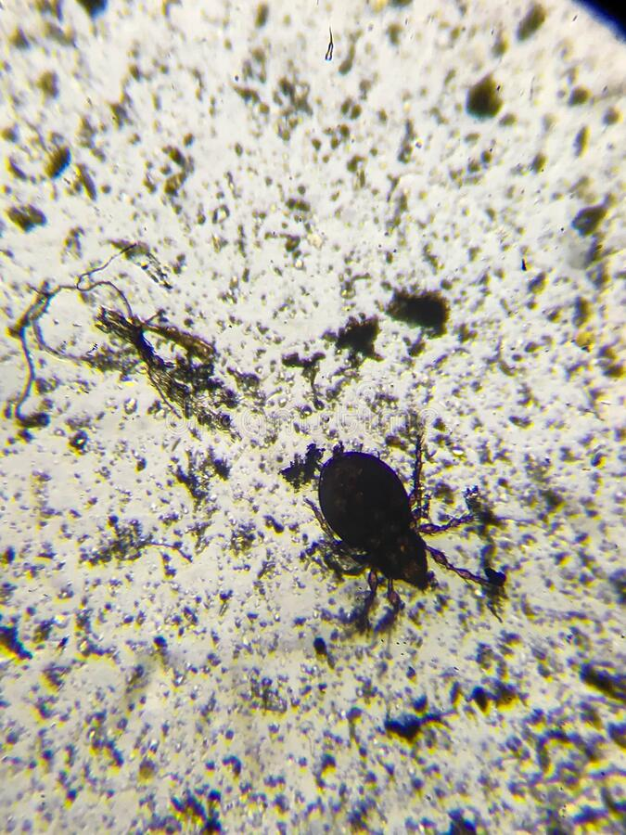
Transfer Learning = Reusing trained model for a different problem
?
↔
Source: ImageNet, Dreamstime.com
Notes:
VOTE: Who thinks it’s a good idea? Ask people who think it’s a good idea why?

Slide 33
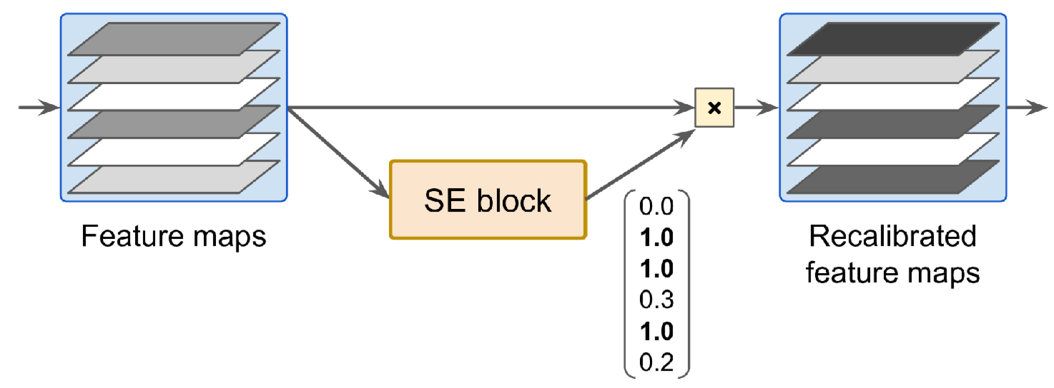
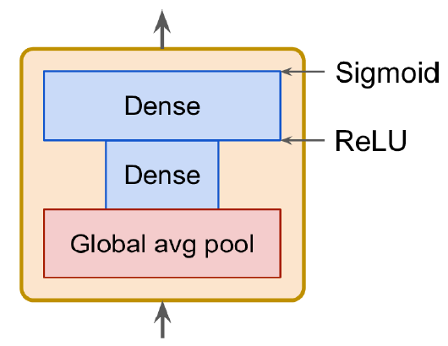
Which model to choose?
See Géron Ch14 for list of high-performance models:
AlexNet (Stacked convolutions + local response normalization)
SENet (Adds small neural networks to recalibrate feature maps)
Fully-convolutional architectures (process images of various sizes)

Slide 34
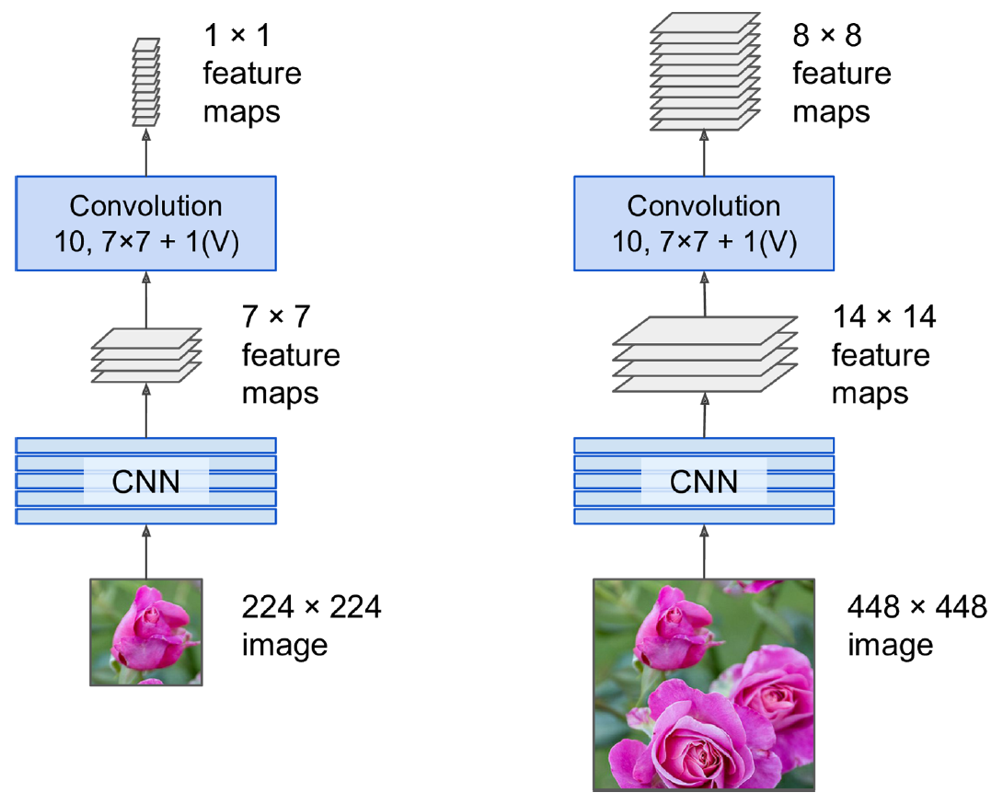
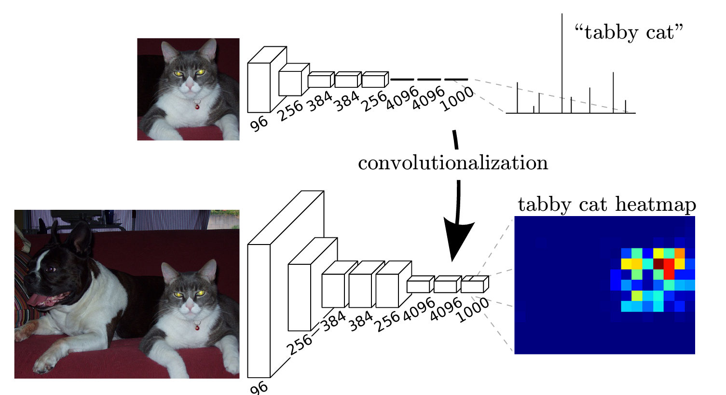
Fully-Convolutional Network = No dense layers Can process image of any size for semantic segmentation
Source: Long et al. (2015)

Slide 35
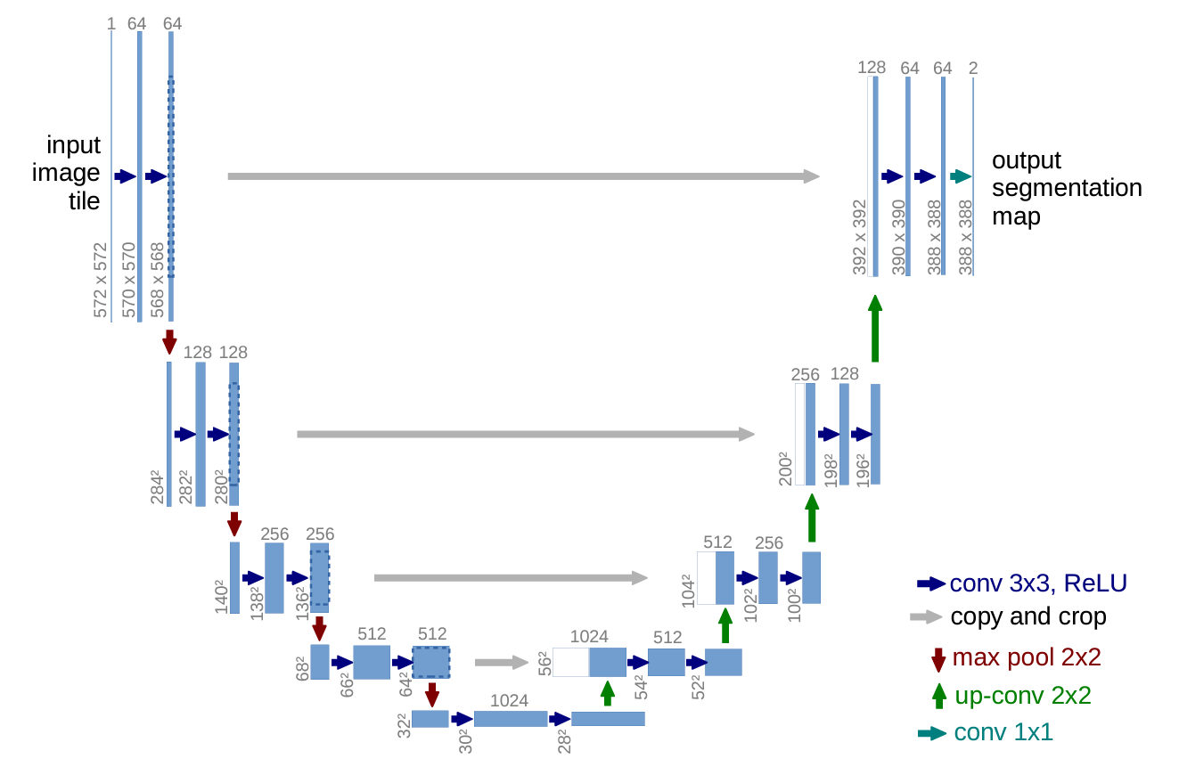
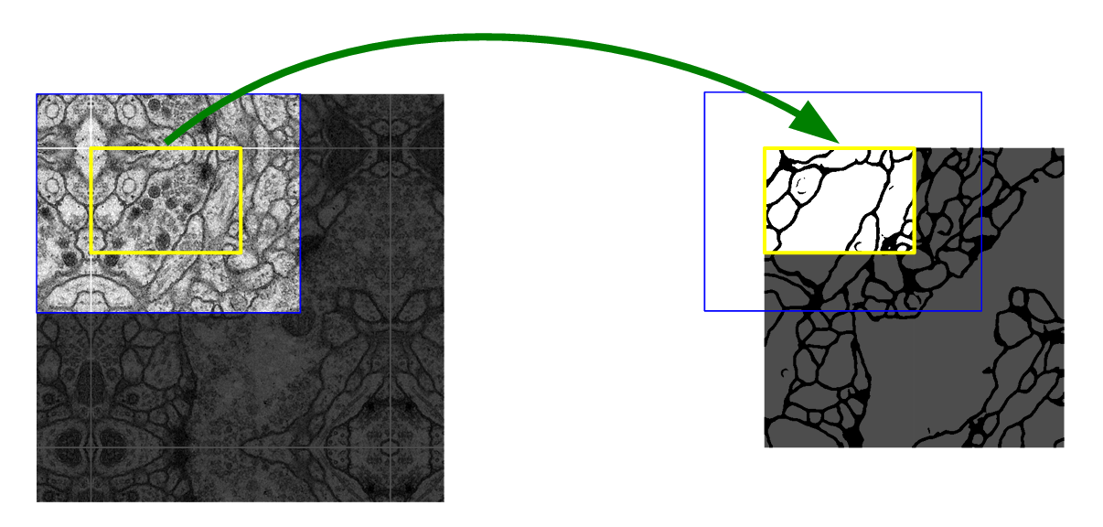
U-Net: Initially developed for biomedical image segmentation. Retains localization information
Source: Ronneberger et al. (2015)

Slide 36
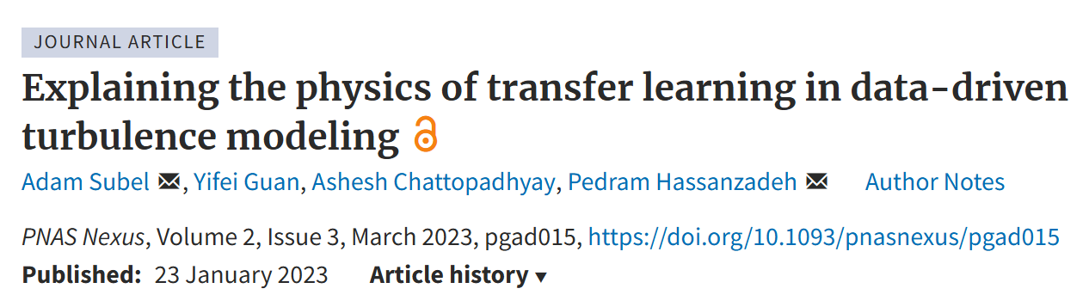
Transfer Learning = Reusing trained model for a different problem
Pick a model to reuse
Load the trained weights corresponding to a similar dataset
Retrain parts of the model - Freeze existing layers & add dense layers to train - Retrain the first layers of model (closest to the image, most specialized)

Slide 37
Min 105-120: Moodle Quiz Review (5 questions, 15 min)
Learning Objectives (Géron Ch17, Haynes et al.):
Define generative modeling
Know different ways of adding uncertainty to ML models
Understand how to evaluate such uncertainty estimates
Know three state-of-the-art generative models
Apprehend applications of latent data representations
Notes:
Questions?
Not graded

